Slide 1


Slide 2
Ludicrous engine
Not Fast, Just Furious!

Slide 3
Who are we?
Naveen Prasad
Colin Pugh
Christian Lee

Slide 4
What is ‘Ludicrous engine’?
Ludicrous Engine is a powerful tool used to design and create awesome 2D games
Uses C++ as the main coding language and SFML as its graphics library

Slide 5
What’s implemented so far?
System Requirements Test
Audio Component
Base Component
Rigidbody Component
Render Component
SceneGraph Component
Transform Component
Manage GameObjects
Particle Systems
Physics System
Input Handling

Slide 6
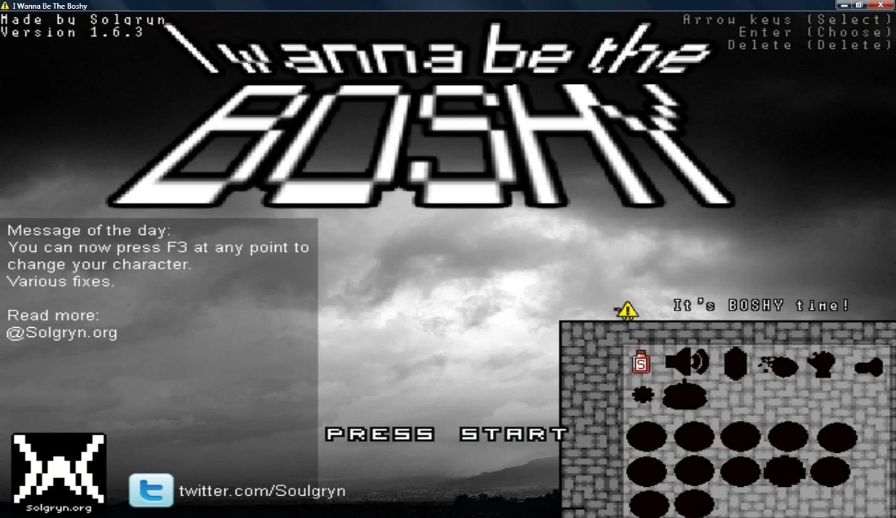


Engine inspiration

Slide 7
Enough talking!
LETS DEMO WHAT WE GOT

Slide 8
What do we need in the future?
Begin development towards milestone 2
Go through all the components and classes and ensure they are connected and working properly
Add missing components if needed
Comment code in all classes and functions for easily readability

Slide 9
Do you have any questions for us?

